Slide 1
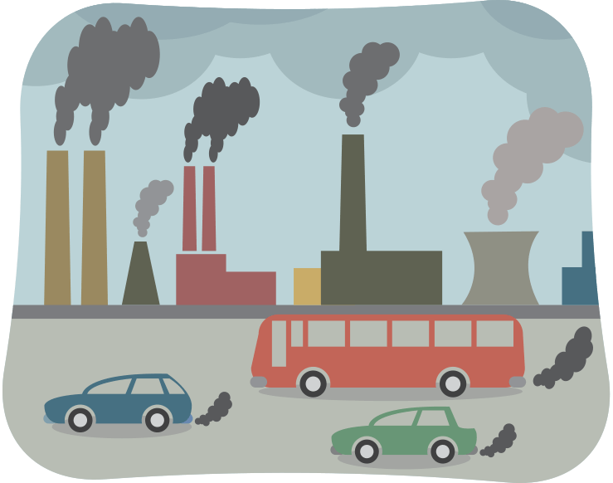

Innovative Modelling Techniques in R
TRAP:
A Novel Road-level Spatial Interpolation to Improve Estimation Errors of Air Pollution
Hyesop Shin
Research Associate
MRC/CSO SPHSU
University of Glasgow
* TRAP: Traffic-related Air Pollution

Slide 2
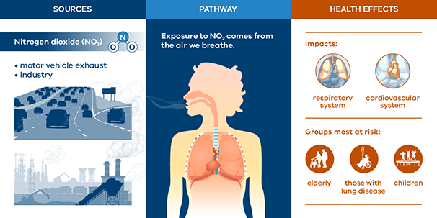
Facts about NO₂ Exposure: Did you know?
Source
Pathway
Health Effect
NO2: A gas that is mainly produced during the combustion of fossil fuels
27% of UK NO2 account for traffic emission
Short-term NO2 can cause inflammation of the airways
e.g. Bronchitis, Asthma
Figure: https://www.epa.vic.gov.au/
Notes:
Short-term exposure to concentrations of NO2 can cause inflammation of the airways
Bronchitis
Nose and eye irritation
Pulmonary fibrosis
Asthma attacks (together with O3)

Slide 3
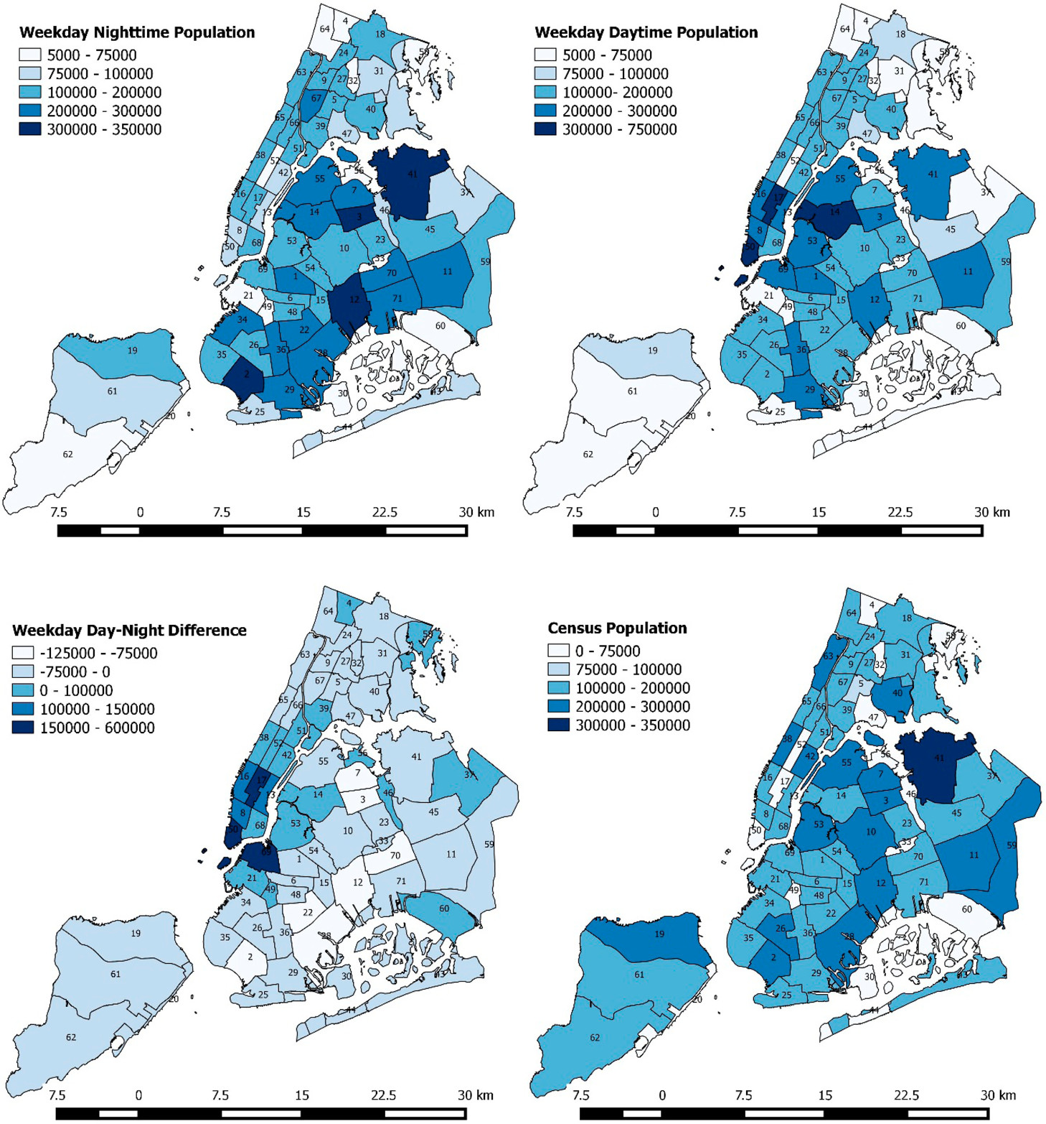
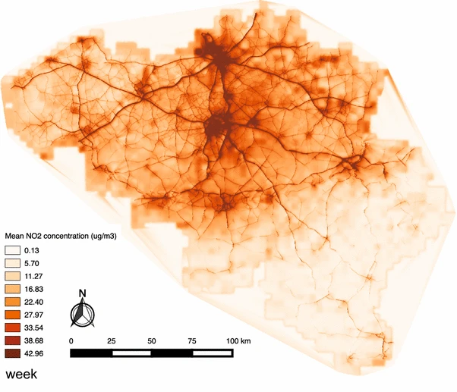
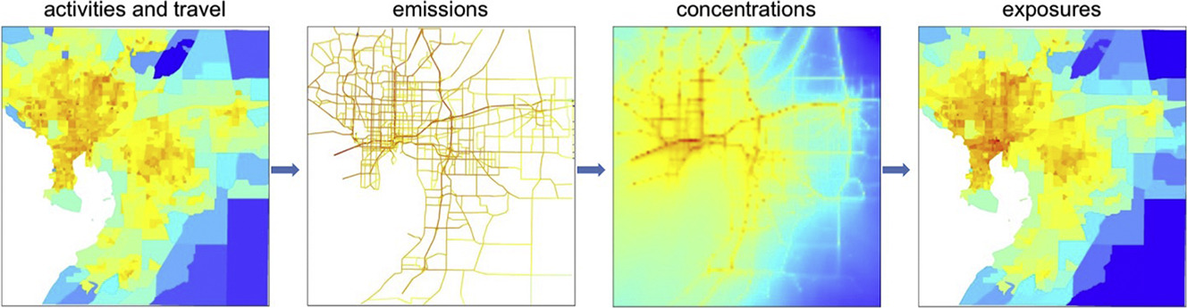
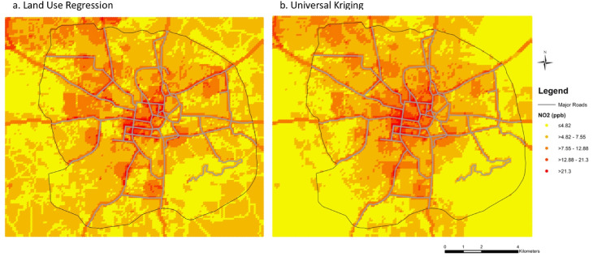
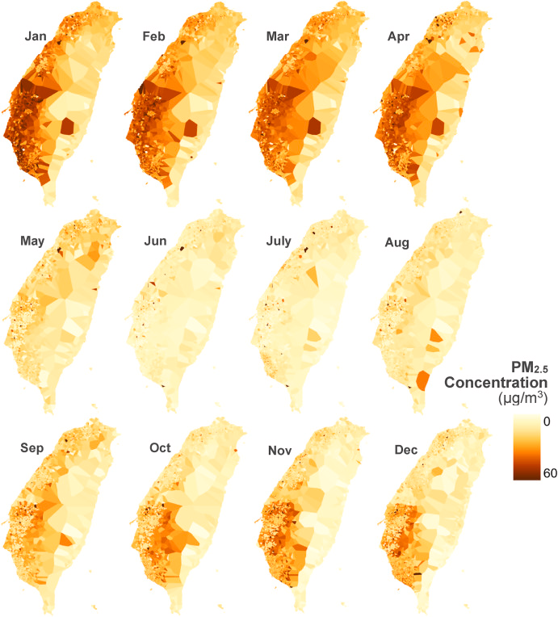
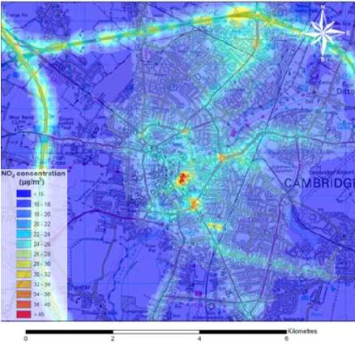
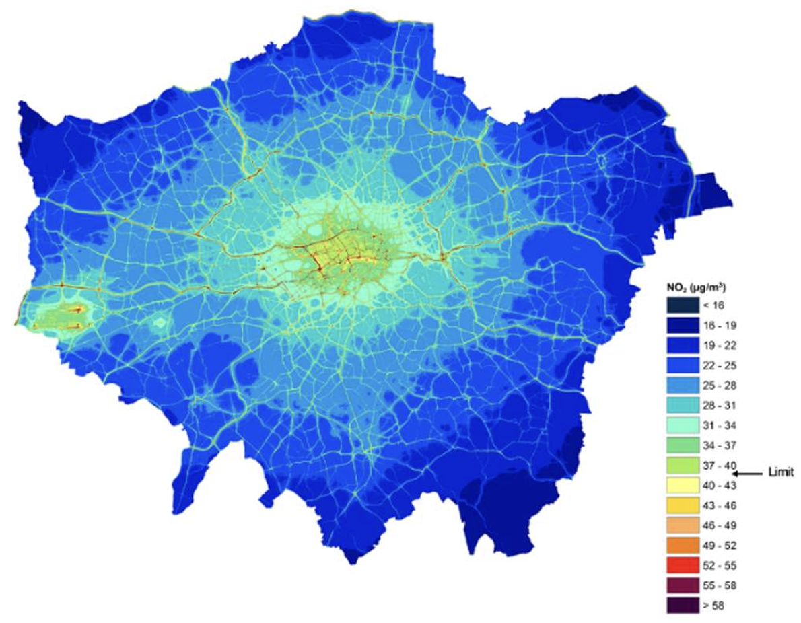
Methods to estimate ‘ Population Exposure’
Gurram et al (2019): R-Line
Nyhan (2016): IDW
Dewulf et al (2016): LUR, Road emissions, Gaussian Plume
Camb City Council (2016): Gaussian Plume
London Air Emission Inventory (2019): Gaussian Plume + Street Canyon
Nori-Sarma et al. (2020):
LUR, Universal Kriging
Chen and Lin (2022):
CIDW

Slide 4
Methods to estimate ‘Population Exposure’
Geostatistical Modelling
Atmospheric Modelling
Given we have a temporally rich but spatially poor pollution data,
why don’t we start from a computationally light, reproducible, and mathematically sound model?
Statistical properties of the observations (e.g. Kriging)
Pros: Mathematically sound concept, quick implementation speed, easy data aggregation, and useful software
Cons: Artefacts, Not fully addressing small-scale variation, smoothed (no emission)
Mathematical assumptions to measure the impact of emission of atmosphere (e.g. CALPUFF)
Pros: Consider Meteorological Impact
Cons: Long execution, Requires lots of computational power and learning curve, Aggregated Measure, Multiple software

Slide 5
Objective
To develop an air pollution package in R that allows anyone to easily generate a pollution map
To examine small-scale variations that occur during SI prediction
To introduce a new road-scale spatial interpolation method that employs road weighting

Slide 6
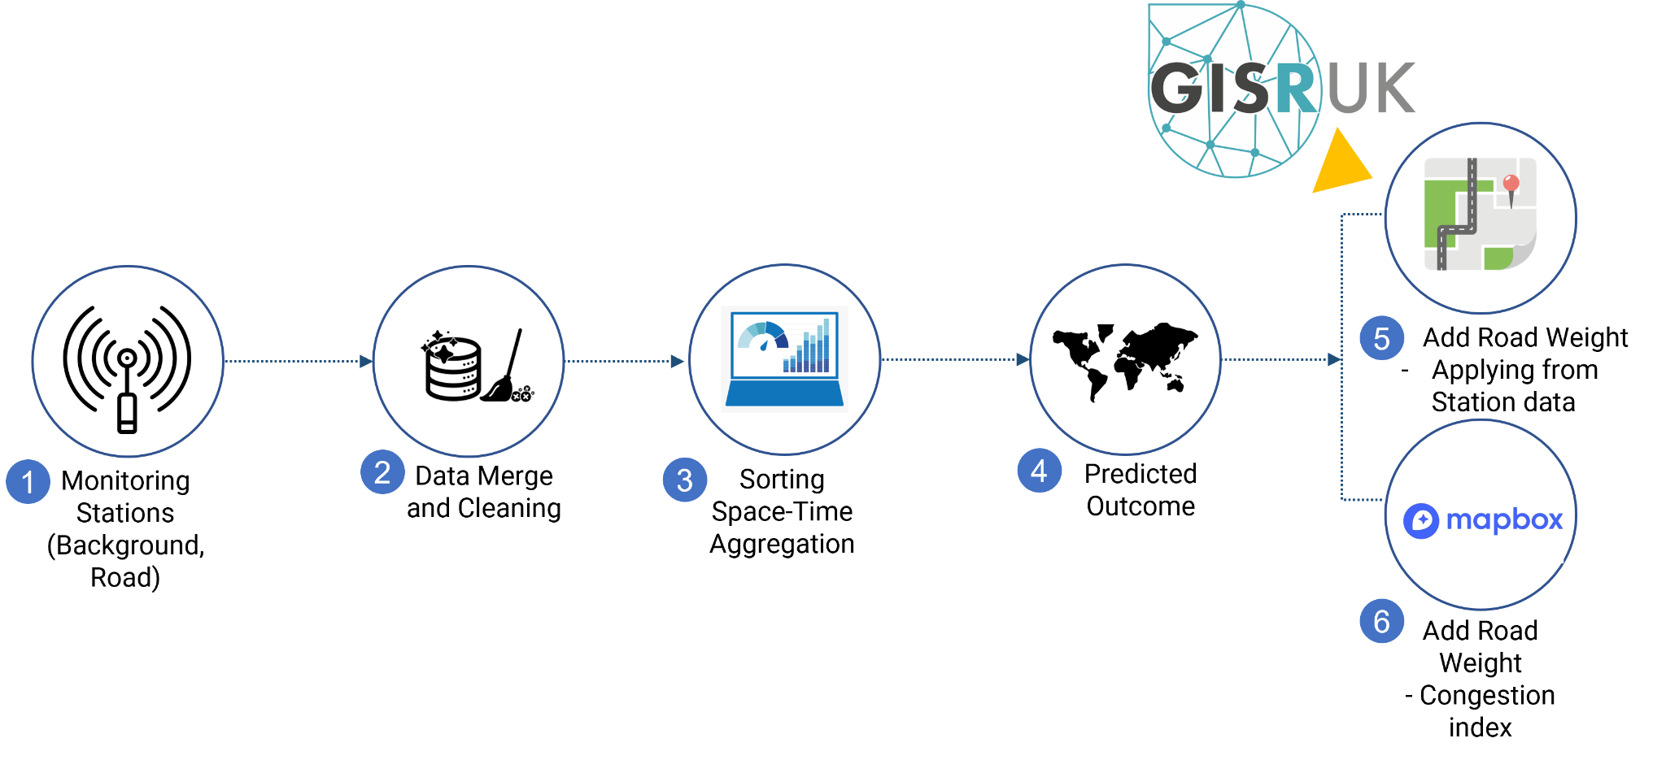
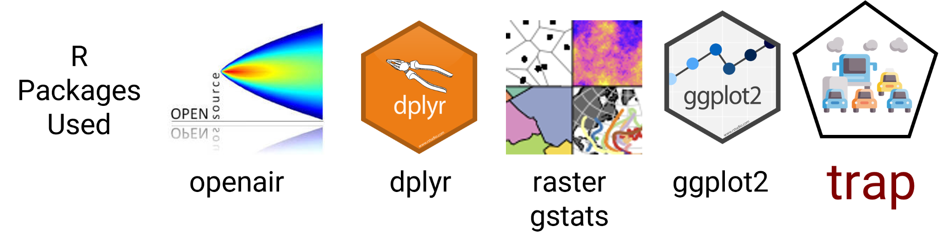
Roadmap

Slide 7
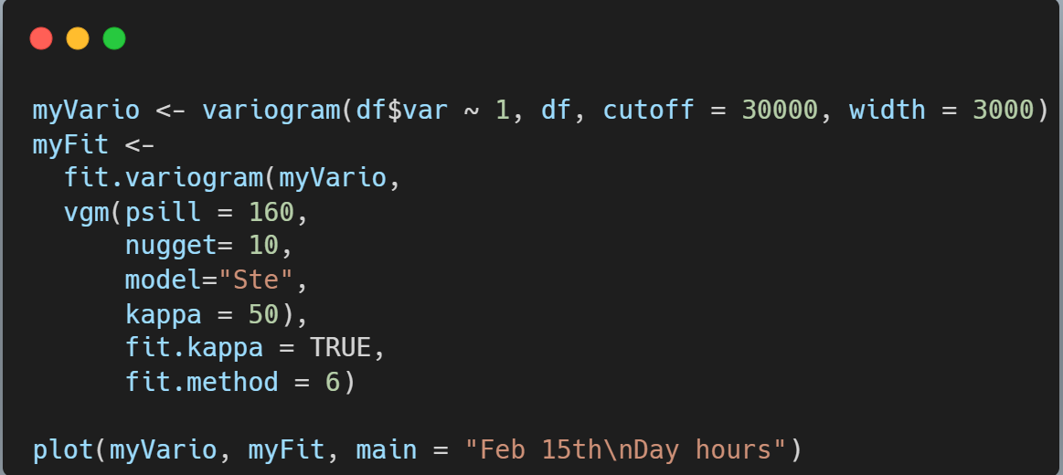
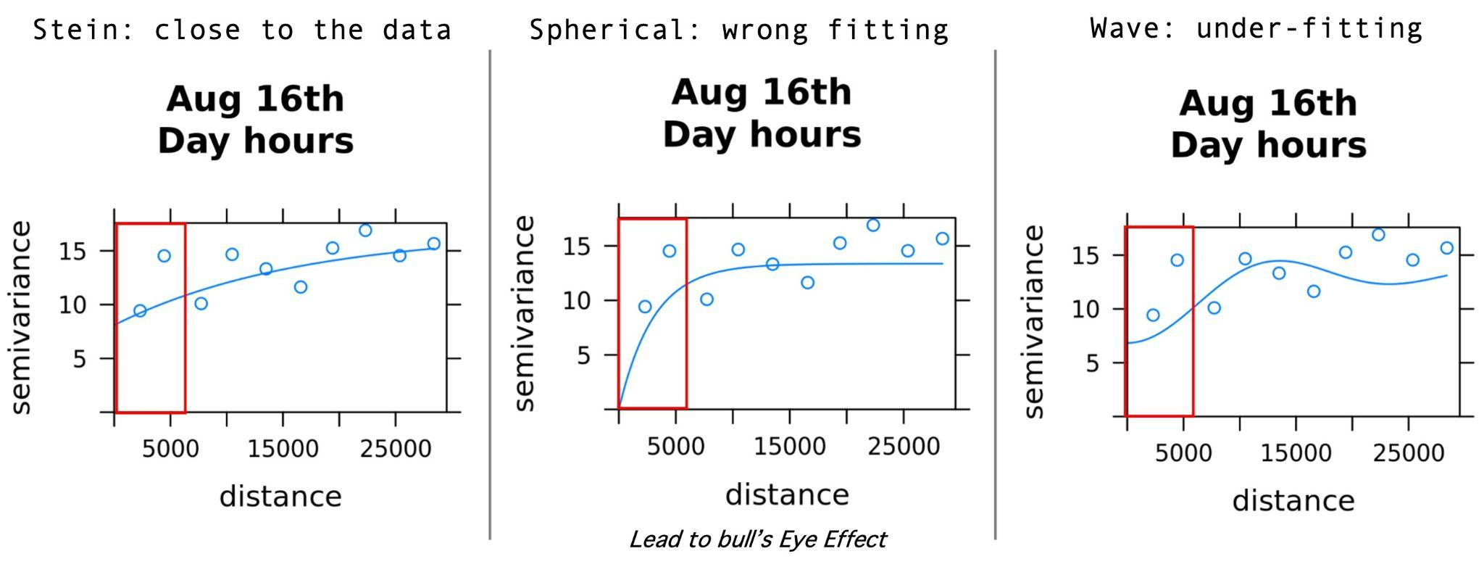
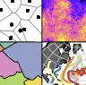
Modelling with Universal Kriging
Considering Small-scale Variability is needed
Since NO2 varies substantially between nearby stations, it might be difficult to get a perfect empirical semivariogram. “AutoKrige” in the automap package might help us find near to the goodness-of-fit.
Executed in R “gstats” package

Slide 8
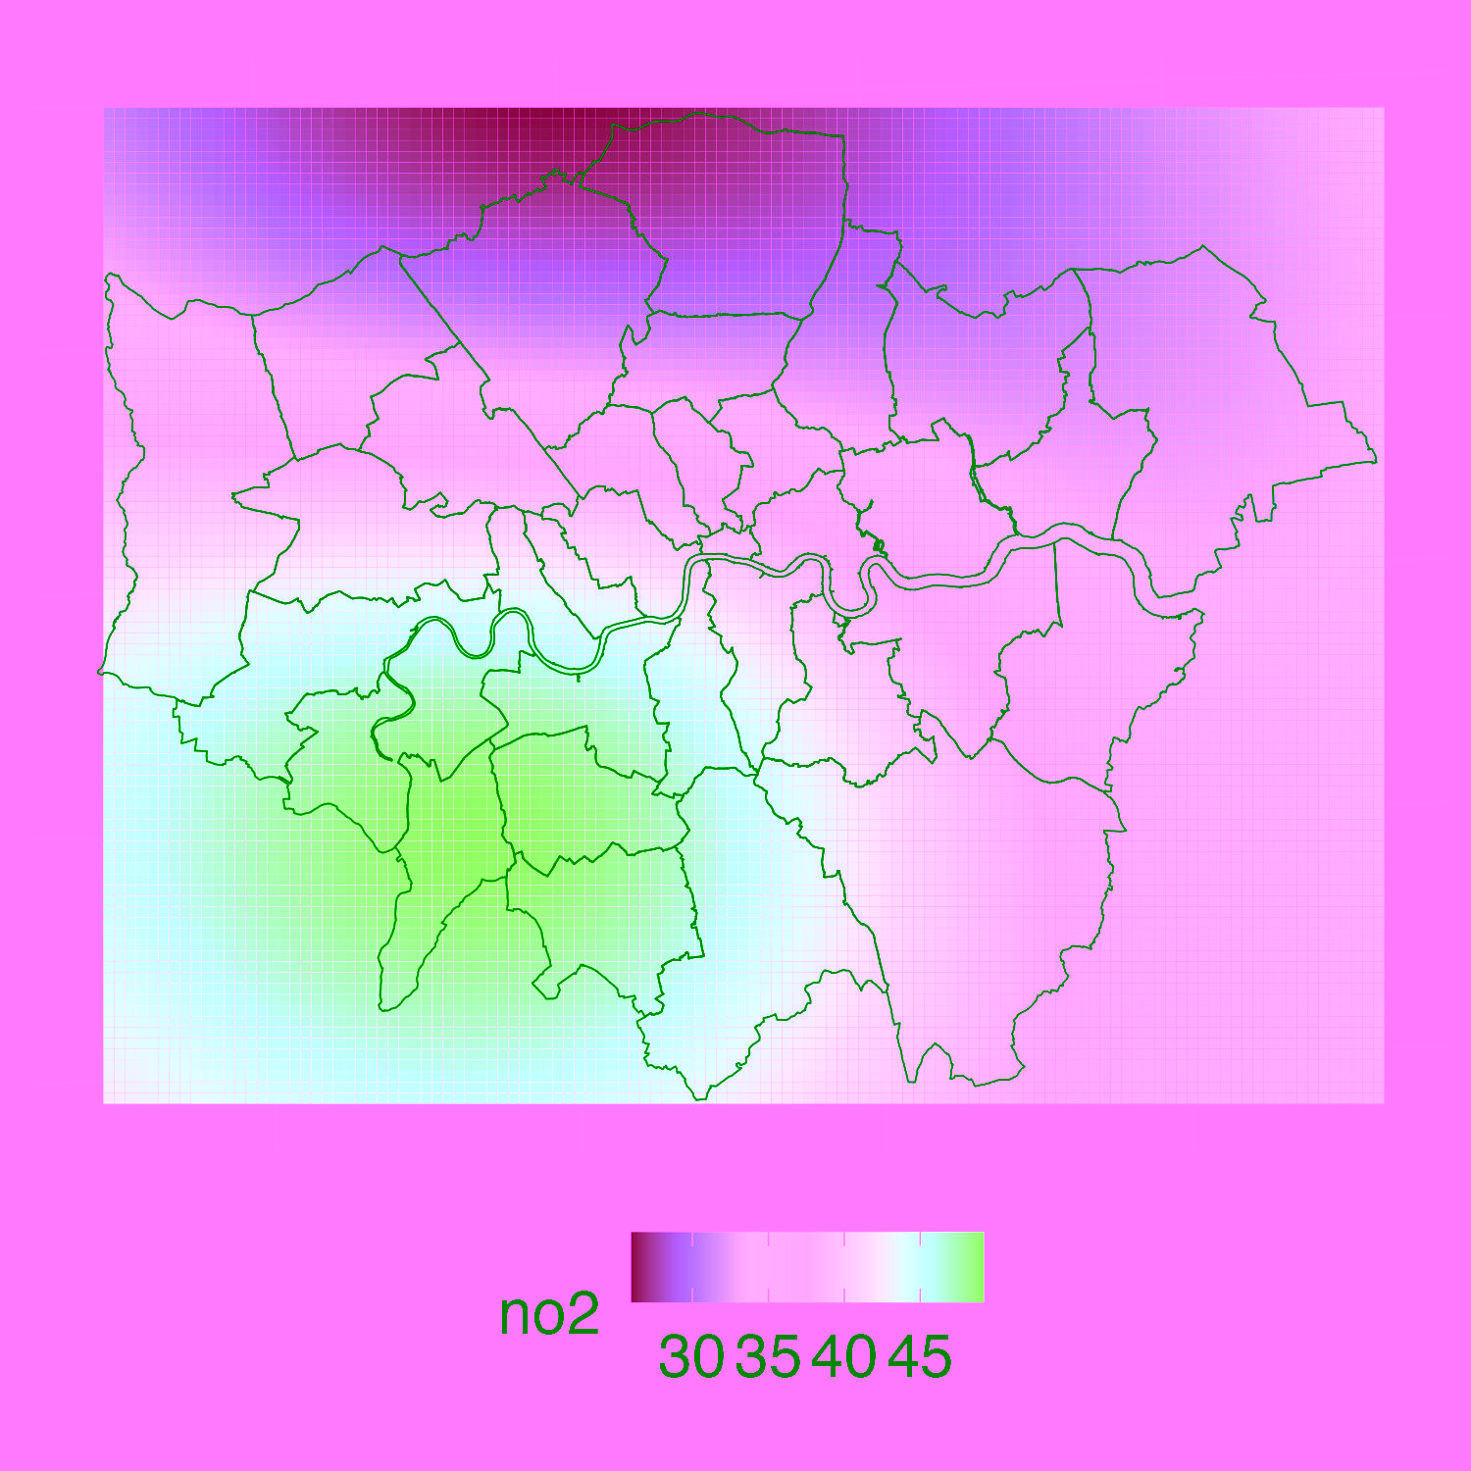
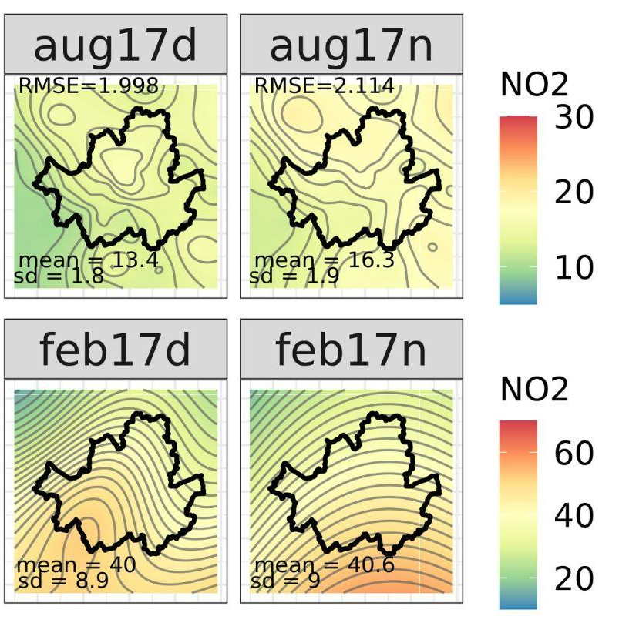

Daily Kriged Output...but too smoothed
18th April 2019
London
17th Aug 2013 17th Feb 2014
Seoul

Slide 9
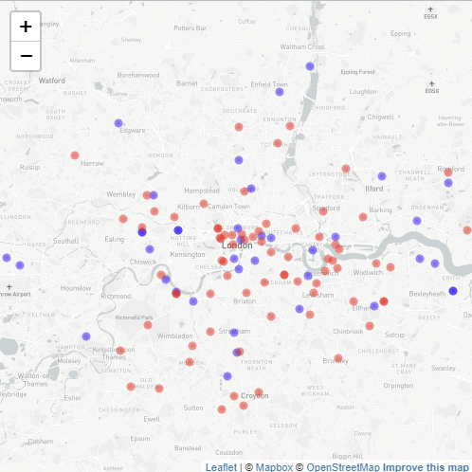
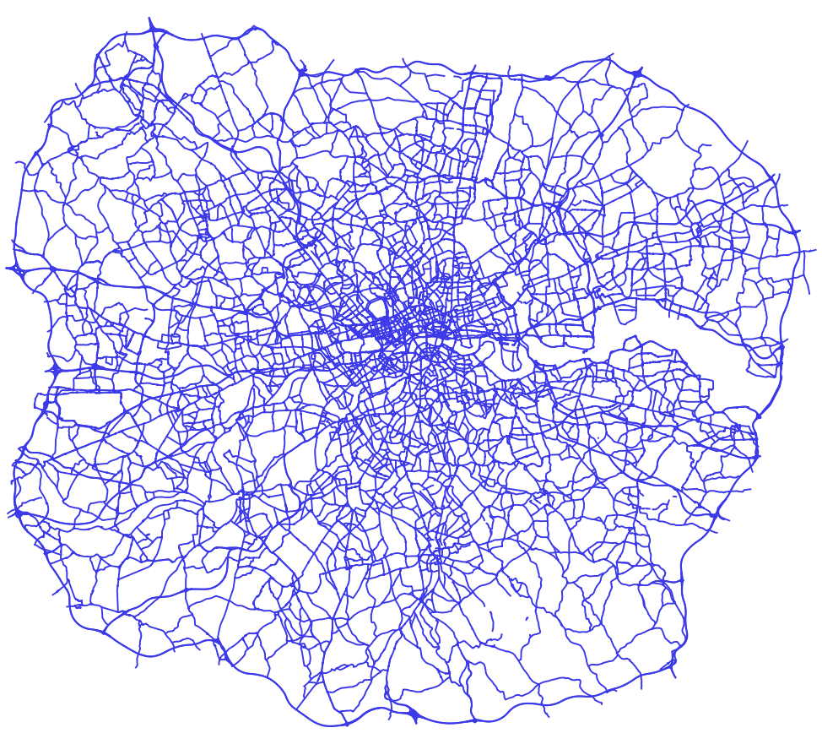
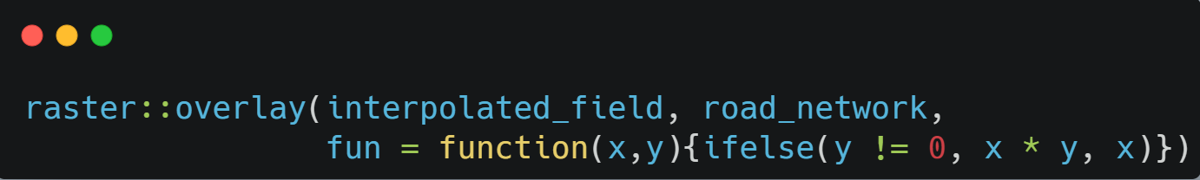
Adding Road Weights
Kriged Output
Roadside Pollution
Road Weight
NO2 Background Stations
“openair” package
importKCL background stations in London
“openair” package
importKCL road stations in London
Apply Road weight By Road type “Raster” package overlay function is key

Slide 10
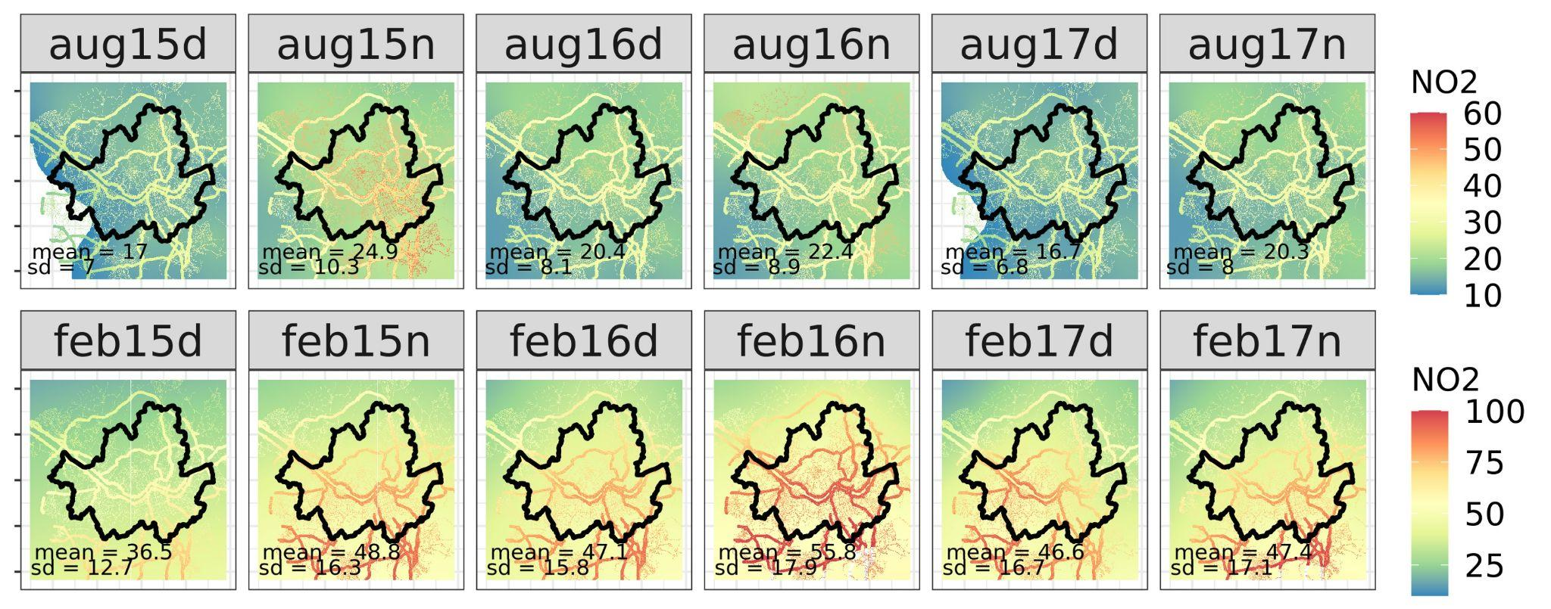
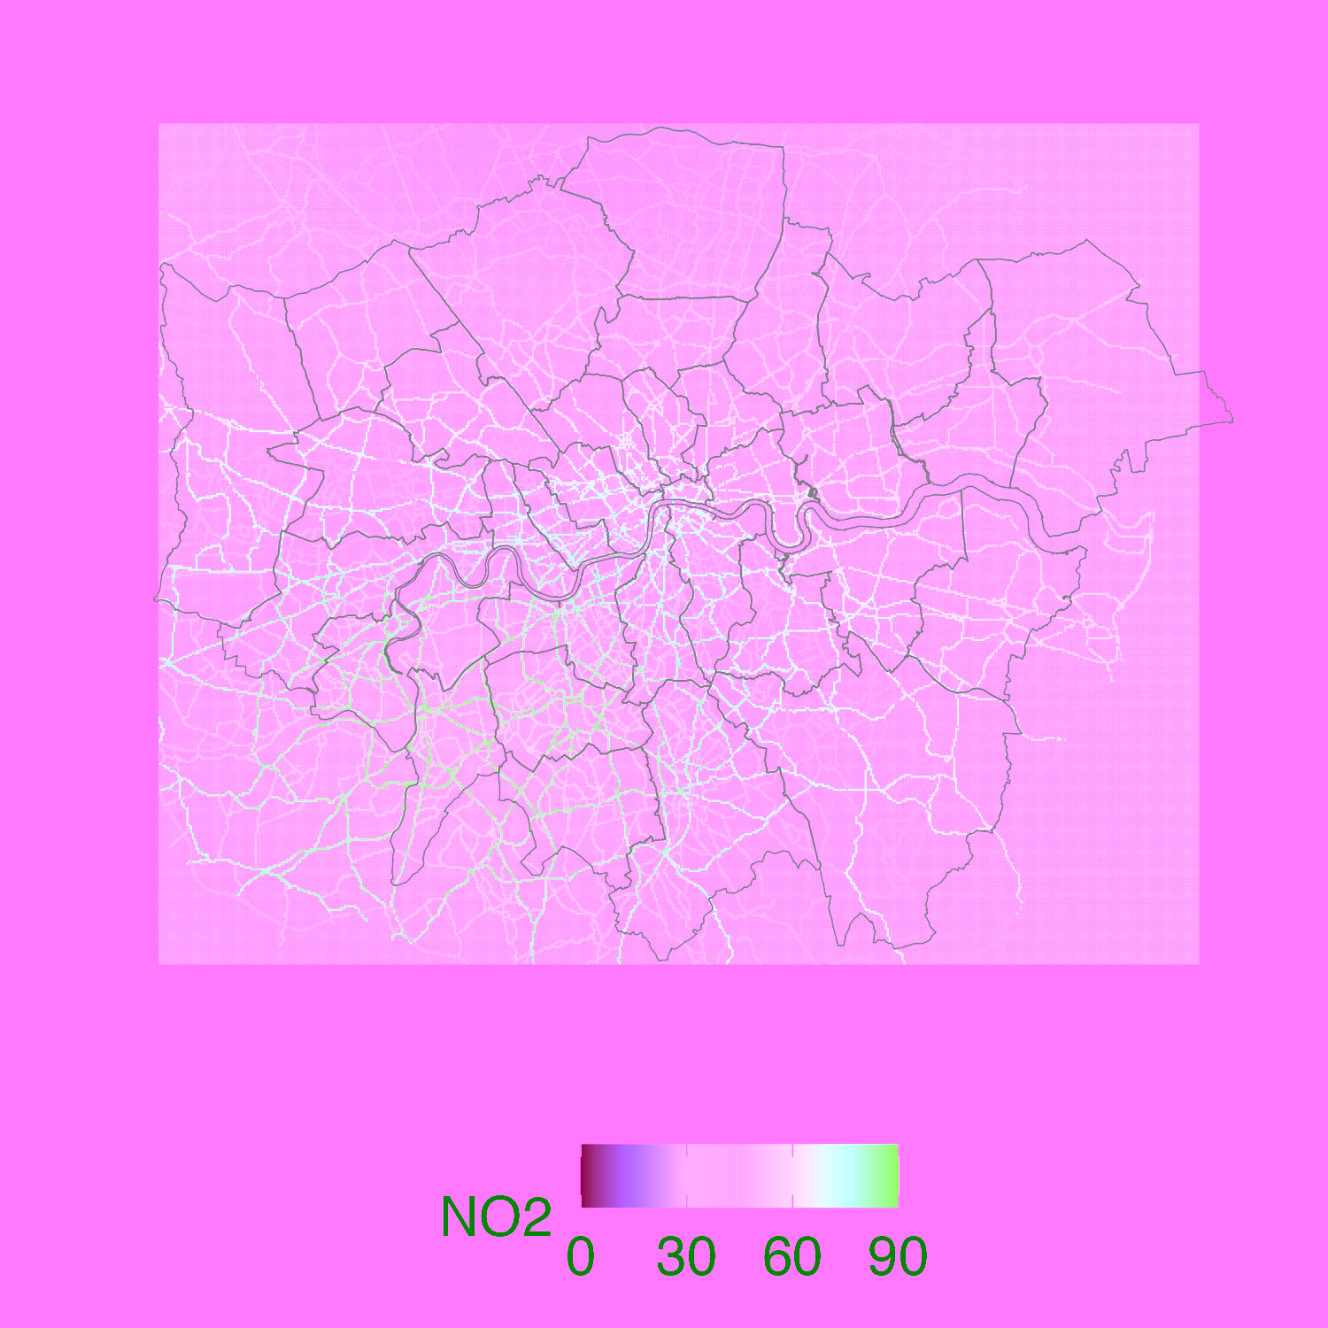
Results
Spatially
Gives a fairly good understanding in City Scale
Not so attractive aesthetics
Surely can zoom into street canyon level
17th Aug 2013 Seoul
Temporally
18th April 2019
London
Any temporal aggregation is possible
Weekly, Monthly had less spatial variability to consider
17th Feb 2014
Seoul

Slide 11
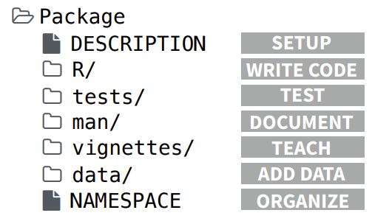


To put it in a package?
get_seoul_no2(year = 2023, add_all = T)
get_london_no2(year = 2023, add_all = T)
Data
Functions
In line with the tibble ecosystem
get_back_road_ratio
overlay_road
Documentation
Long way to go…

Slide 12
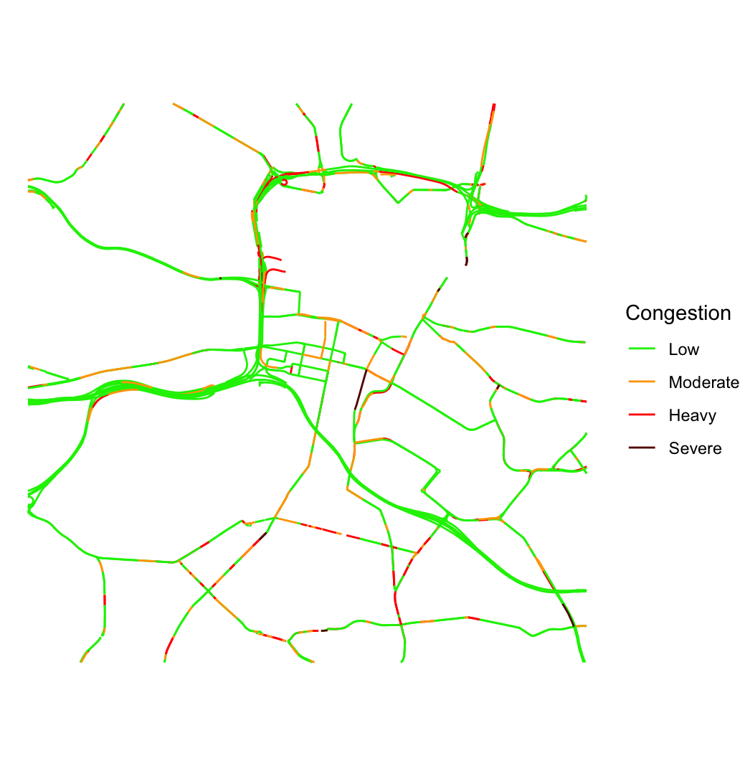
Summary
Modelling Population Exposure to Air Pollution
When modelling population exposure, accurate prediction of NO2 is key. No golden rules for method choice, but for finer temporal intervals, you have to consider small-scale variability even more Finer temporal population is helpful (e.g. Daytime/Nighttime Population)
Understanding the R Ecosystem is important for public use
Like other computer languages, R Ecosystem changes continuously. Making the best use case is to add the road weight with the “big brothers” e.g. tibble, sf, dplyr
Next Steps: Adding Congestion index on Road Weight
Mapbox-provided vector tileset that you can use to display real-time traffic conditions on a map. Updated approx 8 mins Low, Light, Heavy, Severe

Slide 13


Thank you!
Do you have any questions?
hyesop.shin@glasgow.ac.uk
@hyesop
github.com/dataandcrowd/GISRUK2023

